Slide 1
What’s New for TY2020 in Tax Law, Scope and TaxSlayer
12/30/20 updates labelled v4.0
1/3/21 updates labelled v5.0 (Consolidated Appropriations Act, 2021 - CAA 2021)

Slide 2
Types of Changes
Federal Tax Law Changes
Changes Impacting Income
Changes Impacting Adjustments/Deductions
Changes Impacting Credits
Changes Impacting Payments
Inflation Adjustments
Miscellaneous Changes
Summary of New IRS Forms and Lines
NJ Tax Law Changes
Scope Changes
TaxSlayer (TSO) Changes

Slide 3
Federal Tax Law Changes

Slide 4
Changes Impacting Income

Slide 5
Payments Excluded from Wages
Employer may pay up to $5,350 annually for employee education expenses that can be excluded from wages
Now includes student loan repayments
Payments excluded from taxable wages on W-2
May appear in Box 14
Under CARES Act, applied to payments made 3/27/20 – 12/31/20
CAA 2021 extends this provision from 2021 - 2025
Taxpayer cannot claim deduction or credit for items paid by employer
v5.0

Slide 6
Payments Excluded from Wages
cont’d
Higher Education Emergency Financial Aid Grants not included in gross income
School grant under the CARES Act for unexpected expenses, unmet financial need, or expenses related to the disruption of campus operations on account of the COVID-19 pandemic
Food, housing, course materials, technology, health care, or childcare
Student applies through school, so notification of grant will be from school
Taxpayer cannot claim deduction or credit for expenses paid with the grant for Tuition and Fees deduction or Lifetime Learning Credit
Will not be included on Form 1098-T
Need to ask in interview or see student’s school financial account
CAA 2021 specifies no reduction of expenses for American Opportunity Credit
v5.0
v5.0

Slide 7
IRAs - Contributions
Maximum age to contribute to traditional IRA repealed
Used to be 70½
Must have taxable compensation during the year to contribute to IRA
Taxable alimony is considered compensation
Taxable non-tuition fellowships and stipends considered compensation (must be included in gross income)
Paid to aid in individual’s pursuit of graduate or postdoctoral study
Cannot offset Required Minimum Distribution with IRA contribution
Two separate events
2019 IRA contribution deadline extended to 7/15/2020 (usually 4/15)
v4.0

Slide 8
IRAs/Qualified Retirement Plans – COVID-Related Distributions
Special distribution rules for “qualified individuals” with coronavirus-related distributions in tax year 2020 (see next slides for definition)
10% early distribution penalty waived
Can spread income over a 3-year period
Can recontribute funds within 3 years
Treated as a rollover so not included in taxable income
Up to $100,000 of distributions
Distribution exempt from normal 20% mandatory withholding

Slide 9
IRAs/Qualified Retirement Plans – COVID-Related Distributions
cont’d
v4.0
From any qualified retirement account
Includes pensions and minimum distributions
Repayment option has limits
Complete Form 8915-E
Non-COVID disasters remain out of scope
v4.0

Slide 10
IRAs/Qualified Retirement Plans – “Qualified Individual”
cont’d
Notice 2020-50: a qualified individual is anyone who:
is diagnosed, or whose spouse or dependent is diagnosed, with the virus SARS-CoV-2 or the coronavirus disease 2019 (collectively, "COVID-19") by a test approved by the Centers for Disease Control and Prevention (including a test authorized under the Federal Food, Drug, and Cosmetic Act); or
experiences adverse financial consequences as a result of the individual, the individual's spouse, or a member of the individual's household (that is, someone who shares the individual's principal residence):
being quarantined, being furloughed or laid off, or
having work hours reduced due to COVID-19;
being unable to work due to lack of childcare due to COVID-19;
closing or reducing hours of a business that they own or operate due to COVID-19;
having pay or self-employment income reduced due to COVID-19; or
having a job offer rescinded or start date for a job delayed due to COVID-19
The individual/spouse/household member must qualify, not the distribution
v4.0

Slide 11
Deferral of Coronavirus-Related Distributions
v4.0
Can designate eligible taxable distributions up to $100,000 from all plans
Taxpayer can choose whether to designate, or not designate, any eligible distribution
Must treat all designated distributions the same
1/3 taxed in each of 2020, 2021, and 2022
Reduce taxable amount by any repayments

Slide 12
Repayment of Coronavirus-Related Distributions
v4.0
Can repay up to $100,000 at ANY time within 3 years from day after date of distribution
Cannot repay inherited IRA distribution, pension, RMD (?), annuity
Repay to ANY qualified account that can accept it
Includes, for example, 401(k) to IRA
Multiple repayments up to $100,000 total allowed
If repaid, treated as a rollover
Does not count for 1-in-12 months rule
If repay amount previously taxed, file amended return

Slide 13
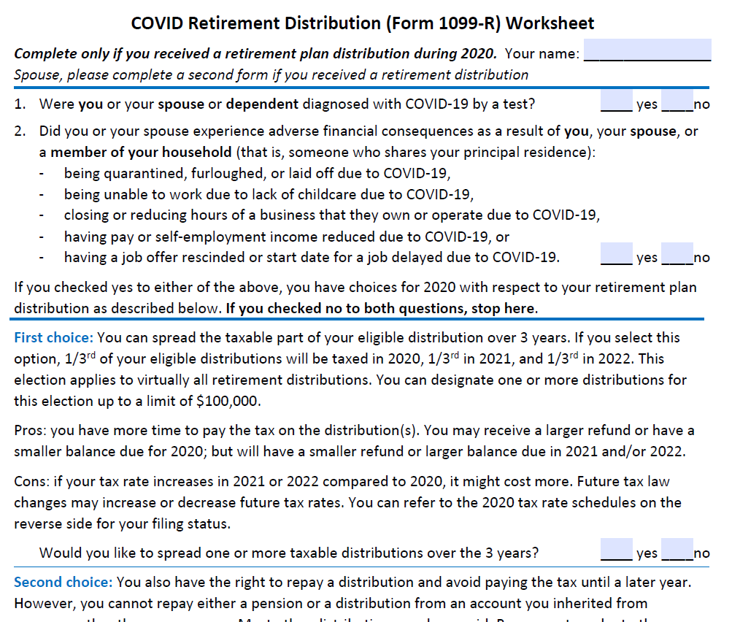
COVID Retirement Distribution Worksheet
v4.0

Slide 14
IRAs/Qualified Retirement Plans - Penalty-Free Distribution for Birth or Adoption
Can withdraw up to $5,000 for the birth or adoption of a child
Distribution within one year after birth or adoption finalized
“Eligible adoptee:” any individual under age 18 or physically or mentally incapable of self-support
Not a child of the taxpayer’s spouse
Each spouse can use this exception to the penalty
Can claim more than once (e.g. - twins born or adopted)
Can recontribute any portion of the distribution as a rollover contribution to an eligible retirement plan
Recontribution can be to any plan to which a rollover can be made
Treated as a rollover made timely
v4.0
v4.0

Slide 15
IRAs/Qualified Retirement Plans - Penalty-Free Distribution for Birth or Adoption
cont’d
Distributions can be from an IRA, 401(k), 403(b), etc.
Not from a defined benefit plan
Will use exception code “Other” on Form 5329

Slide 16
IRAs/Qualified Retirement Plans – Required Minimum Distributions (RMDs)
cont’d
RMD waived for 2020 only
If already taken, could recontribute RMD by 8/31/20
Does not count as a rollover for 1-in-12-months rule
Age for beginning RMDs increased to 72 from 70½
Only for individuals who reached age 70½ after December 31, 2019
Some or all of first distribution may be delayed until April 1 of following calendar year (no change)

Slide 17
IRAs – Qualified Charitable Distribution (QCD)
Previously, starting at age 70½, a taxpayer could transfer up to $100K directly from their traditional IRA to a charity and exclude the amount of that QCD from their AGI
Under new law:
Minimum age for QCD from IRA remains at 70½
Excludible amount of the QCD must now be reduced by the cumulative amount of all IRA contributions that the taxpayer claimed as an IRA deduction (on Schedule 1 Line 19) after the age of 70½
Must use cumulative amount unless all or part of that cumulative amount had already been used to reduce a QCD in prior years

Slide 18
QCD and IRA Contribution Example
v4.0
Taxpayer is over age 70 ½ in this example:
Deducted $5,000 IRA contributions in each 2020 and 2021, no contribution 2022
No QCD in 2020, $6,000 QCD in 2021, $6,500 QCD in 2022
2021 QCD is reduced by $10,000 prior IRA contributions so no QCD
2022 QCD is reduced by remaining prior deducted IRA contributions($10,000 - $6,000 =) $4,000
QCD is ($6,500 - $4,000 =) $2,500
Notes:
Example from Notice 20-68
Taxpayer age is > 70 ½ for all years
Notice does not address deductibility of charitable contributions not treated as QCDs

Slide 19
IRAs – Inherited IRAs
Stretch IRAs curtailed for decedents dying in 2020 or later
Previously, an heir could stretch out required distributions from an inherited IRA based on his life expectancy, not the original account owner’s
Now, Secure Act generally mandates that inherited IRAs must be emptied within 10 years of the death of original account holder
Exceptions for eligible designated beneficiaries
Spouse
Not more than 10 years younger than the decedent
Chronically ill minor children
Also applies to 401(k) and Roth accounts

Slide 20
Qualified Retirement Plans - Loans
For plan loans made to a qualified individual from March 27, 2020, to September 22, 2020, loan limits may be increased to lesser of:
$100,000 (minus any other outstanding loans) OR individual’s vested benefit under the plan
No income tax due if paid back within 5 years
If any loan is outstanding on or after March 27, 2020, and has a repayment due between March 27 – December 31, 2020, that due date may be delayed for up to one year
Interest still accrues

Slide 21
Self-Employment - Paycheck Protection Plan (PPP) Loan
A self-employed person was eligible for a PPP loan
Max 2.5 months' worth of their 2019 Sch C profit
Loan is forgivable if certain rules are followed
Funds are “used” to pay self-employed person for lost profit – no reduction of expenses needed
CAA 2021 specifies all expenses remain deductible
A second round of PPP loans was implemented under CAA 2021
Will go through March 31, 2021
v5.0
v5.0
Notes:
IRS issued Notice 2020-32 that expenses incurred to get the tax-free PPP money are not deductible
Applies to PPP recipients that incurred payroll or certain overhead expenses and used those expenses to get forgiveness

Slide 22
Self-Employment - Expensing Cost of Goods
Self-employed taxpayers can expense the cost of goods purchased for resale or as raw materials in the year purchased (effective 1/1/2018)
Enter as supplies or “other expenses” in TSO (not in cost of goods sold)
Cost of goods sold section of Schedule C remains out of scope

Slide 23
Expansion of Section 529 Plans
More expenses now qualify for tax-free and penalty-free withdrawals from a qualified tuition program (529 plan)
Distributions now permitted for:
Principal or interest on a student loan
Loan can be for designated beneficiary or a sibling
Can withdraw up to $10,000 lifetime limit to pay down qualified student loans on beneficiary’s loan; additional $10,000 limit for each sibling’s loan
Interest paid with these funds does not qualify for the student loan interest deduction
Participation in an apprenticeship program that is registered and certified by the U.S. Department of Labor.
Qualifying expenses are required fees, books, supplies and equipment
Retroactive to 2019
Notes:
More expenses now qualify for tax-free and penalty-free withdrawals from a qualified tuition program, also known as a 529 plan.

Slide 24
Changes Impacting Adjustments/Deductions

Slide 25
Adjustments to Income
Tuition and fees deduction for higher education expenses extended through 2020
Repealed after 2020
$250 educator expense adjustment can now be claimed for costs associated with personal protective equipment (PPE)
Paid or incurred after 3/12/20
v5.0
v5.0

Slide 26
Above-the-Line Charitable Contribution Deduction
For TY2020, maximum $300 deduction per return for cash contributions to charity can be claimed, even if not itemizing
IRS specifies up to $150 if filing MFS (IR-2020-278)
CAA 2021 extended deduction through 2021 and raised limit to $600 for MFJ for 2021
Claim on 1040 Line 10b
v5.0
v5.0

Slide 27
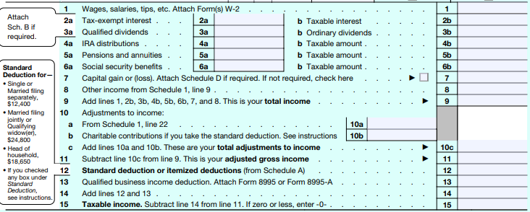
Above-the-Line Charitable Contribution Deduction on 1040 Line 10b

Slide 28
Deductions on Schedule A
Threshold for medical expenses stays at 7.5% of AGI for 2020
7.5% made permanent starting in 2021
Cash charitable contributions limit increased
For tax year 2020 and 2021, up to 100% of AGI allowed (up from 60%)
Mortgage insurance premiums deduction extended through 2021
PMI treated as interest
Mileage deductions
Business miles decreased – 58 to 57.5 cents/mile
Medical miles decreased – 20 to 17 cents/mile
Charitable miles – fixed by law at 14 cents/mile
v5.0
v5.0
v5.0

Slide 29
Deductible Meal Expenses for Self-Employed
IRS issued new regulations for deduction allowed for meal expenses for self-employed taxpayers for 2020
Business meals 50% deductible for 2020
Provided clarification on rule that deduction not allowed for entertainment, amusement, or recreation expenses
For details, link to https://www.irs.gov/pub/irs-drop/td-9925.pdf
Business meals 100% deductible for 2021-2022
Must be provided by a restaurant
Reverts to 50% for 2023
v4.0
v5.0
Notes:
IRS issued new regulations
https://www.irs.gov/pub/irs-drop/td-9925.pdf
Examples:
Business conducted while eating – in a restaurant or brought in
Business dinner with business discussion after a business conference
Regs keep statutory exeptions:
IRC §274(e) Specific exceptions to application of subsection (a)Subsection (a) shall not apply to—
(1) Food and beverages for employees furnished on the business premises of the taxpayer primarily for his employees.
(2) Expenses treated as compensation
(3) Reimbursed expenses
(4) Recreational, etc., expenses for employees
(5) Employees, stockholder, etc., business meetings
(6) Meetings of business leagues, etc.
(8) Entertainment sold to customers
(9) Expenses includible in income of persons who are not employees.

Slide 30
Changes Impacting Credits

Slide 31
Sick Leave Credit for Self-Employed Individuals – Part I
If self-employed individual is unable to work because:
They’re subject to a COVID-19 quarantine or isolation order
They’re advised to self-quarantine because of COVID-19
They have COVID-19 symptoms and are seeking a medical diagnosis
Up to 10 lost workdays between 4/1/20 and 12/31/20
CAA 2021 extended period through 3/31/2021 – assume any 2021 credits will be reported on 2021 tax return
Calculate credit by multiplying number of lost days by lesser of:
$511 per day (total max $5,110) OR
100% of “Average daily self-employment income” (annual net self-employment income divided by 260)
CAA 2021 allows use of 2020 or 2019 self-employment profit – whichever is more beneficial
v5.0
v5.0

Slide 32
Sick Leave Credit for Self-Employed Individuals – Part II
cont’d
If self-employed individual unable to work because:
They’re caring for someone who is subject to a COVID-19 quarantine or isolation order, or for someone who is advised to self-quarantine because of COVID-19
They’re caring for a child whose school or place of care is closed due to COVID-19
They’re caring for a child whose childcare provider is unavailable due to COVID-19
Up to 10 lost workdays between 4/1/20 and 12/31/20
CAA 2021 extended period through 3/31/2021 – assume any 2021 credits will be reported on 2021 tax return
Calculate credit by multiplying number of lost days by lesser of:
$200 per day (total max $2,000) OR
67% of “Average daily self-employment income” (annual net self-employment income divided by 260)
CAA 2021 allows use of 2020 or 2019 profit – whichever is more beneficial
v5.0
v5.0

Slide 33
Sick Leave Credit Limit
v4.0
Self-employed sick leave credit scaled down if individual also got sick leave from an employer as reported on W-2 or separate statement
We will rely on taxpayer’s good faith representation
Example:
$1,500 of Part II Self-Employment sick leave equivalent (previous slide)
$900 of $200-limit sick leave wages as employee
Reduce Part II Self-Employment sick leave credit limit ($2,000) by $900 leaving $1,100 available limit for $1,100 credit
Notes:
For Part II, maximum is $2,000 sick leave wages come off first.
IRS issued Notice 2020-54 for employers to report leave pay on W-2 or separate statement
We’ll rely on the taxpayer’s good faith representation

Slide 34
Family Leave Credit for Self-Employed Individuals
If the self-employed individual is unable to work because
They’re caring for a child whose school or place of care is closed due to COVID-19
They’re caring for a child whose childcare provider is unavailable due to COVID-19
Can claim family leave credit for up to an additional 50 lost workdays between 4/1/20 and 12/31/20
CCA 2021 extended period through 3/31/2021 – assume any 2021 credits will be reported on 2021 tax return
Calculate credit by multiplying number of lost days by lesser of:
$200 per day (total max $10,000) OR
67% of “Average daily self-employment income” (annual net self-employment income divided by 260)
CAA 2021 allows use of 2020 or 2019 profit – whichever is more beneficial
v5.0
v5.0

Slide 35
Family Leave Credit Limit
cont’d
Scaled down if individual also got family leave from an employer as reported on W-2 or separate statement
We will rely on taxpayer’s good faith representation
Example:
$5,000 Self-Employment family leave equivalent (previous slide)
$9,000 family leave wages
Family leave credit limit ($10,000) reduced by $9,000 leaving $1,000 available limit for $1,000 credit
v4.0

Slide 36
Sick/Family Leave Credits for Self-Employed Individuals
cont’d
Self-employed individual can receive both sick leave credit and family leave credit for up to 60 lost workdays of credits
Each spouse can claim the credit(s) if they have a business
Note overlap of caring for child in both sick leave Part II and family leave credit
Form instructions do not prohibit using the same lost workdays for both credits
These are refundable credits
IRS guidance: https://www.irs.gov/newsroom/special-issues-for-employees#specific-provisions-related-self-employed-individuals
v4.0

Slide 37
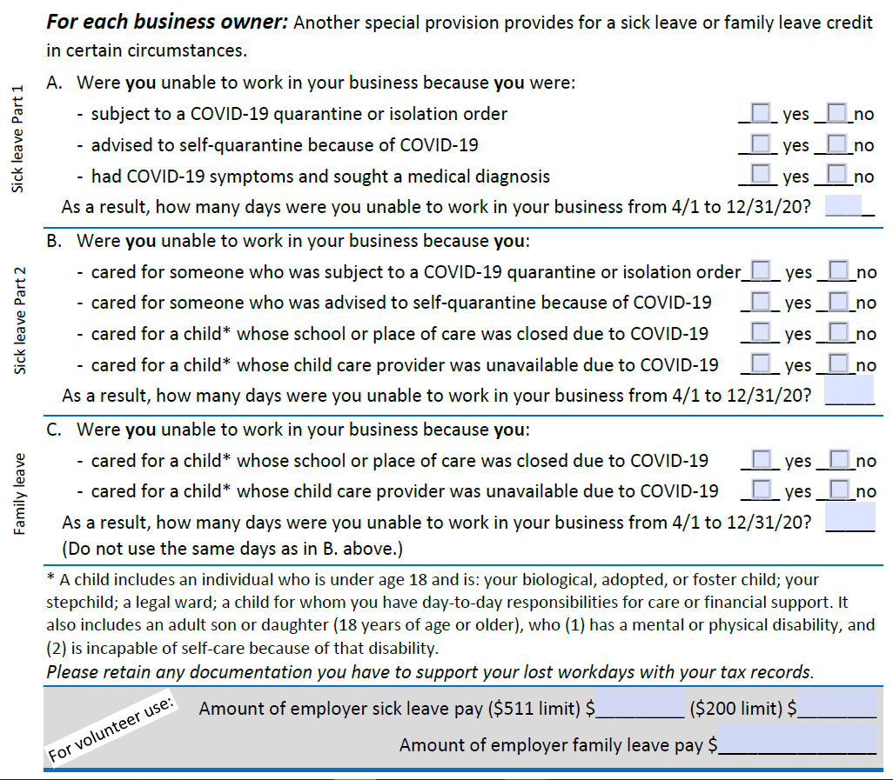
New Self-Employed COVID Worksheet
v4.0

Slide 38
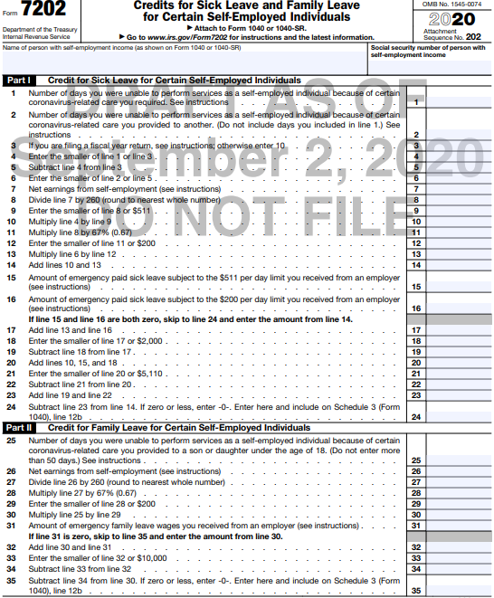
New Form 7202 Credits for Sick Leave and Family Leave for Certain Self-Employed Individuals

Slide 39
New Line on Schedule 3
Payments or refundable credits section

Slide 40
Original Economic Impact Payments (EIP)
EIP was an advance payment of the Recovery Rebate Credit
EIP sent to eligible taxpayers during 2020
$1,200 ($2,400 MFJ)
$500 per dependent under age 17 as of 12/31/2019 (or 12/31/2018 if that return was used)
Income phaseout
MFJ $150,000 – $198,000
HoH $112,500 – $136,500
S, MFS, QW $75,000 – $99,000
Notes:
EIP was an advance payment of the Recovery Rebate Credit

Slide 41
Recovery Rebate Credit (RRC)
Can claim a RRC credit on 2020 tax return if entitled to more EIP
Refundable credit
Will need to know how much EIP was received
TSO asks for this amount in the Basic Information section
Examples generating RRC
Qualified taxpayer received no EIP in 2020
Additional qualifying dependent on 2020 return
2019 income above phaseout maximum, but 2020 income below phaseout
v4.0
Notes:
The amount was on the White House letter separately sent
Intake form has a new line “Receive an Economic Impact Payment (stimulus) in 2020?” in life events

Slide 42
Economic Impact Payments and Recovery Rebate Credit
EIP and RRC are not taxable income
Taxpayers eligible to be claimed on another’s return not eligible for EIP or RRC
Taxpayers must have valid Social Security number
EIP and RRC may be offset for past-due child support
Does not apply to other Federal offsets
Notes:
IRS recently announced that offset EIP for injured spouses that filed F8379 for 2019 will be paid out – no action needed

Slide 43
2020 Recovery Rebate Credit
Excessive EIP does not have to be paid back
Possible exception for deceased recipients’ estates
No form – there will be a worksheet in the 2020 1040 instructions (page 57 of IRS draft version - available on IRS.gov)
IRS cannot reissue White House letter (notice 1444)
No IRS plans to have a look-up tool

Slide 44
EIP Non-Filer Tool
Individuals that used the Non-Filer tool and need to file a real 2019 tax return
If try to e-file, will reject
Will need to file a paper return
Page one should have “Amended EIP return” at the top
Notes:
Individuals that used the nonfilter tool and need to file a real 2019 tax return will need to file a paper return
Page one should have “Amended EIP return” at the top

Slide 45
RRC New Line on 1040
Payments and refundable credits section

Slide 46
Second Recovery Rebate Credit (RRC) Under CAA 2021
v5.0
Each individual must have valid SSN or ATIN on the return
Decedents dying before January 1, 2020 treated as not having a SSN
$600 for single, $1,200 MFJ
$600 if only one spouse has SSN
Different than EIP/RRC under CARES Act – both spouses had to have SSN to get any payment
MFJ members of military get full $1,200 if at least one spouse has SSN
$600 per dependent child (under age 17)
If over 17, eligible for stimulus payment, but only if not claimed as a dependent on someone else’s return
Same income phase-out levels as under CARES Act
Second RRC, if any, applies to 2020 return even if payment not received until 2021

Slide 47
Second RRC
v5.0
Treasury has until January 15, 2021 to issue advance payments of the additional recovery rebate
IRS can base payments on 2019 tax return data
Taxpayer can claim more credit on 2020 return
Still no provision to return an excess payment

Slide 48
Lookback for EIC/ACTC
v5.0
Taxpayer can elect to use 2019 earned income in lieu of 2020 earned income for
Earned income credit
Additional child tax credit
Prior year earned income is the sum of the earned income of both spouses for MFJ returns

Slide 49
Other Credit Changes
Residential energy credit extended through 2020 and 2021
Lifetime Learning Credit will have increased income limits (same as American Opportunity Credit)
Made permanent starting in 2021
v5.0
v5.0

Slide 50
Changes Impacting Payments

Slide 51
Self-Employment - Payroll Tax Deferral
Self-employed person can defer the employer portion of Social Security tax (not Medicare portion)
Compute the self-employment income attributed to 3/27/20 – 12/31/20
77.5% of annual income
50% of the deferred self-employment tax will be due December 31, 2021
Balance will be due December 31, 2022
Taxpayer can choose to defer less than the maximum
Will not affect the adjustment to gross income for half the S-E tax
v4.0
v4.0
Notes:
Will TaxSlayer make this automatically? TBD

Slide 52
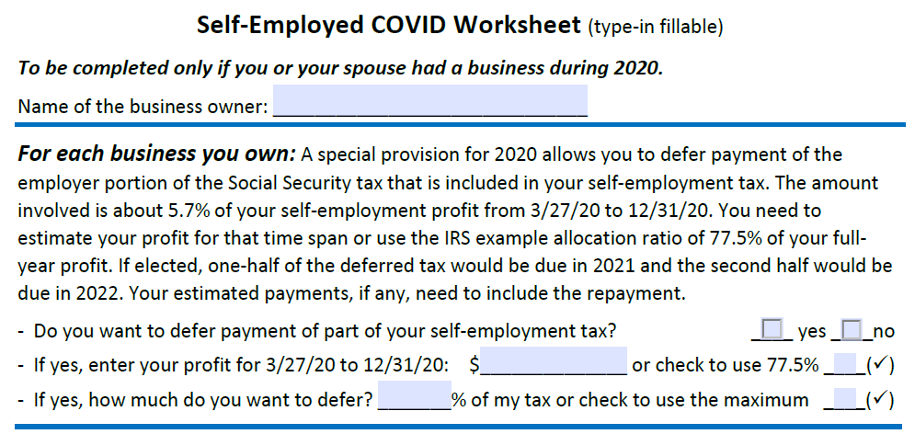
New Self-Employed COVID Worksheet
v4.0

Slide 53
Self-Employment - Payroll Tax Deferral
New Schedule SE Part III
Notes:
Will TaxSlayer make this automatically? TBD

Slide 54
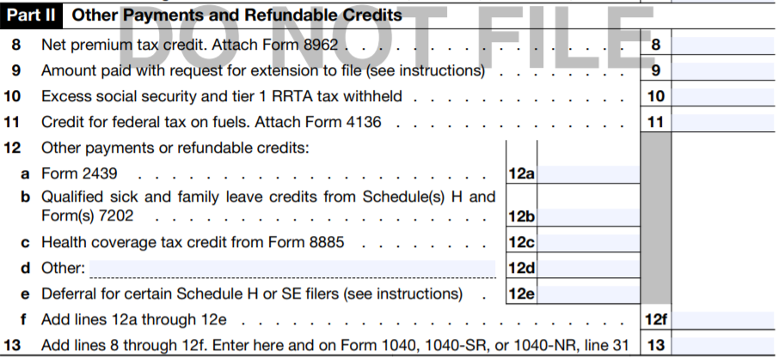
Self-Employment – New Line 12e on Schedule 3 for Payroll Tax Deferral

Slide 55
Estimated Tax Payments
2020 payments for 2020 normally due 4/15/20 or 6/15/20
Treated as timely when made by July 15, 2020
See NJ section for due dates for NJ estimated tax payments, as they are different than Federal
Significant processing delays at IRS

Slide 56
New Withholdings Breakdown on Form 1040
Notes:
May be helpful for QR

Slide 57
Inflation Adjustments

Slide 58
Tax Bracket Inflation Adjustments
Wider ranges for tax brackets
Wider ranges for capital gains tax brackets
3.8% surtax on net investment income stays the same
Surtax applies only to high income individuals whose MAGI is:
Over $200,000 (Single, HoH)
Over $250,000 (MFJ, QW)
Over $125,000 (MFS)

Slide 59
Standard Deduction Inflation Adjustments
Standard deduction increased to:
$24,800 MFJ and QW (up $400)
$18,650 HOH (up $300)
$12,400 Single and MFS (up $200)
Additional standard deduction amount for age 65 and older and/or blind
$1,650 S, HOH
$1,300 MFJ, MFS, QW
Dependent standard deduction has not changed

Slide 60
Filing Threshold
Filing thresholds for most taxpayers is their standard deduction
See exceptions in footnotes to Pub 4012 Chart A
Also see Pub 4012 Chart C for other situations that must file
Notes:
Dependent filing threshold Pub 4012 Tab A Chart B

Slide 61
Qualifying Relative Gross Income Test
Personal or dependent exemption deduction is $0 through 2025
Threshold amount is $4,300 for 2020 (up $100)
Used for qualifying relative gross income test

Slide 62
Other Inflation Adjustments
Earned income credit
Max investment income $3,650 (up $50)
Student loan interest deduction income phase out limits
Retirement savings contribution credit income brackets
Education credits income phase out limits
Notes:
Max investment income for EIC $3,650 for 2020

Slide 63
Other Inflation Adjustments
cont’d
Qualified business income (QBI) deduction thresholds
– $326,600 for MFJ
$163,300 for single, HoH, MFS
Scope: if taxable income (before the QBI deduction) exceeds the threshold, return is out of scope
Income limits for IRA deductions and Roth IRA contributions
Notes:
IRA – individual retirement account

Slide 64
Other Inflation Adjustments
cont’d
HSA contribution limits
$3,550 for self-only (up $50)
$7,100 for families (up $100)
Limit on long-term care insurance deduction
Premium Tax Credit (PTC)
Federal poverty lines updated for PTC purposes
Repayment of Advance Premium Tax Credit (APTC) caps
Notes:
HSA – health savings account
APTC – advance premium tax credit

Slide 65
Miscellaneous Changes

Slide 66
Health Savings Accounts (HSAs)
2019 contribution deadline for HSAs extended to July 15, 2020
Funds from HSAs can be used to buy over-the-counter medicines without the need for a prescription
Also applies to Flexible Spending Accounts (FSAs)
Menstrual care products are included
Applies to amounts paid after December 31, 2019
HSA is now part of Advanced certification
No separate test/certification anymore
Notes:
Need guidance on whether more than medicines are covered: supplements, band-aids, icy hot packs

Slide 67
New Qualified Experienced Volunteer Test (QEV)
20 questions
Not required for certification
For seasoned volunteers (test is harder)
Who should take QEV?
Volunteers dedicated to Quality Review
Volunteers who like to be challenged
Can be used by instructors as exercises
Good for Reviewer or Master classes

Slide 68
Qualified Experienced Volunteer Test (QEV)
cont’d
What is on this test?
Unusual family situation (grandparent, single parent, grandchild)
Taxable scholarship
Simplified method for pension
UBER driver with Form 1099-NEC
Kitchen sink problem to be entered into TSO
HSA, lump sum SS, Marketplace health insurance, state income tax refund
Quality Review problem with Intake/Interview sheet, intake documents, and 1040
What is wrong?

Slide 69
New Test for Local/Site Coordinators
A new annual test required for Local/Site Coordinators only
Updated LC/Site Coordinator training slides in Learning Management System (LMS) in Portal
Last module is LC/Site Coordinator test
Do not use version of the LC test in Link and Learn since it doesn’t prove that you completed all the LC training
v4.0

Slide 70
Required Training Courses in Learning Management System (LMS) in Portal
v4.0
LMS assigns each volunteer courses they must complete in the Portal
Courses are based on volunteer position held
All volunteers must complete Policies and Procedures modules

Slide 71
2019 Form 1040X for Amended Returns
IRS will accept e-filed Form 1040X for 2019 if original 2019 return was e-filed
Some issues with TSO implementation of this
Non-Filer “return” to claim EIP is not considered an e-filed 2019 return – paper Form 1040 must be mailed

Slide 72
Individual Taxpayer Identification Numbers (ITINs)
ITINs expiring
Not used in the last three consecutive tax years
Middle digits 88 will expire 12/31/20
Middle digits "90", "91", "92", "94", "95", "96", "97", "98", or "99" assigned before 2013 expire 12/31/20
Need to renew if ITIN will be used on a U.S. federal tax return filed in 2021

Slide 73
Miscellaneous Items of Interest
Draft IRS forms can be found at https://apps.irs.gov/app/picklist/list/draftTaxForms.html
SS annual wage base is $137,700
W-4 Employee’s Withholding Certificate has been revamped
New tax withholdings tables implemented for 2020
IRS now has an IP PIN Opt-In program for anyone who wants an Identity Protection PIN. Can apply through IP PIN tool (unavailable until mid January, 2021)
v4.0

Slide 74
Summary of New IRS Forms and Lines

Slide 75
Form 1040 – New Lines
Line # | Line verbiage | Use
Below address | At any time during 2020, did you receive, sell, send, exchange, or otherwise acquire any financial interest in any virtual currency | Virtual currency use
10b | Charitable contributions if you take standard deduction | Cash charitable donations for non-itemizers
25 | Federal income tax withheld:
25a | Form(s) W-2 | Federal taxes withheld on W-2s
25b | Form(s) 1099 | Federal taxes withheld on 1099s
25c | Other forms | Federal taxes withheld on any other forms
25d | Add lines 25a through 25c | Total of all Federal taxes withheld
30 | Recovery rebate credit | Stimulus payments not received
37 | Amount you owe now Note: Schedule H and Schedule SE filers, line 37 may not represent all of the taxes you owe for 2020. See Schedule 3, line 12e, and its instructions for details | New note for Schedule SE filers who defer payroll taxes

Slide 76
New Lines on Other Forms and New Forms
Form | Line # | Line verbiage | Use
Sch 3 | 12b | Qualified sick and family leave credits from Schedule(s) H and Form(s) 7202 | Credits for sick and family leave credits for self-employed
Sch 3 | 12e | Deferral for certain Schedule H or SE filers | Deferral of payroll taxes for self-employed
1099-NEC |  | Nonemployee Compensation | Source document to report nonemployee compensation
7202 |  | Credits for Sick Leave and Family Leave for Certain Self-Employed Individuals | Credits for sick and family leave credits for self-employed
Sch SE | Part III | Maximum deferral of self-employment tax payments | Deferral of payroll taxes for self-employed
14446 |  | Virtual VITA/TCE Taxpayer Consent | Taxpayer consent to do tax return virtually
13614-C |  | Intake/Interview and Quality Review Sheet | Perforated for ease of scanning
Sch LEP |  | Request for Change in Language Preference | IRS communications in different languages
v4.0

Slide 77
NJ Tax Law Changes

Slide 78
NJ Tax Law Changes
2019 tax return deadline was extended until July 15, 2020
Deadline for first estimated tax payment originally due on April 15, 2020 was extended to July 15, 2020
Deadline for second estimated tax payment remained June 15, 2020
EITC changes:
Age requirement for taxpayers with no qualifying child is now at least 21 and under 65 (used to be at least 25)
EITC increased to 40% of Federal EIC amount (up from 39%)

Slide 79
NJ Tax Law Changes
cont’d
Pension exclusion increased:
$100,000 for MFJ
$50,000 for MFS
$75,000 for S, HOH, QW
NOTE: If NJ gross income is over $100,000, taxpayer is not eligible for any pension exclusion
Unemployment and pandemic relief income is exempt from NJ tax
EIP (stimulus payments)
Unemployment benefits
Pandemic unemployment assistance
Pandemic EBT (Electronic Benefits Transfer) benefits – food stamps

Slide 80
NJ Tax Law Changes
cont’d
For tax year 2020, eligible taxpayers will receive a tax rebate of $500 or less (depending on amount of after credit taxes paid)
To be eligible, taxpayer must have:
At least one qualifying child
Income of $150,000 or less (MFJ, HOH, QW)/$75,000 or less (S, MFS)
After credit income tax liability greater than $0
No taxpayer action required
Payments scheduled to begin 7/1/21 for those filing by 4/15/21

Slide 81
NJ Tax Law Changes
cont’d
Income tax for telecommuters:
Employee who normally works outside NJ, but who is or was working temporarily from home in NJ due to Covid-19, will continue to pay income tax to normal work state
If employee continues to work from home after Covid-19 emergency ends, income is now taxable to NJ and employer should withhold tax for NJ
Medicaid waiver payments
If tax exempt on Federal return, will also be exempt in NJ
If NJ tax withheld in error, taxpayer should request the refund

Slide 82
NJ Tax Law Changes
cont’d
2019 PTR checks to be paid beginning on October 15, 2020
Original income limit remains; no budget payment restrictions
2019 application deadline extended from November 2, 2020 to December 31, 2020
No information about 2020 eligibility requirements yet
2017 Homestead Benefit payments to be credited on property tax bills beginning May 2021
NJ people can now purchase health insurance through NJ Marketplace, rather than healthcare.gov
Maximum income and maximum contribution increased slightly for unemployment insurance, but significantly for disability and family leave insurance
A lot fewer people will have excess withholdings on Form 2450

Slide 83
Scope Changes

Slide 84
Kiddie Tax – Out of Scope (again)
Kiddie tax kicks in at $2,200 of unearned income (after the filing threshold is met)
Kiddie tax reverts to pre-2018 law – child’s unearned income again taxed at parents' top marginal rates rather than trust rates
Kiddie tax in scope only for 2018 and 2019 if electing estate/trust tax rates

Slide 85
Schedule C Expenses
Schedule C expenses in scope up to $35,000
Increased from $25,000
Includes purchases of assets or repairs to assets that cost less than $2,500 per item/invoice that can be deducted without depreciation
No inventories
Cost of goods sold is still out of scope
Includes using standard mileage rate for leased vehicles
Rentals or leases of a vehicle for more than 30 days are out of scope
Notes:
Reminders

Slide 86
Form 1099-INT
Out of scope situations
Box 11, bond premium, has an amount larger than Box 1, taxable interest
Box 12, bond premium on Treasury obligations, has an amount larger than Box 3, interest on US savings bonds and Treasury obligations
Box 13, bond premium on tax-exempt bonds, has an amount larger than Box 8, tax-exempt interest
v4.0

Slide 87
TaxSlayer (TSO) Changes

Slide 88
TSO Changes
Waiting to see how TSO implements all the new tax law changes for 2020
2020 Practice Lab implemented in mid-November did not include all 2020 changes
Changes being implemented as new instructions and guidance are issued by IRS
Follow VITA/TCE blog in TSO to see when new changes are implemented
2020 Practice Lab for NJ not expected until January
If you see something that is not working correctly, check the blog to see if it’s a known issue first
Please do not submit a ticket on the Portal – send the issue to TaxSlayer Support (support@vita.taxslayerpro.com)
Please be patient – will take time for IRS to provide directions and TaxSlayer to implement
v4.0
v5.0

Slide 89
TSO Changes
cont’d
Redesign of e-file section planned for tax year 2020 has been delayed until 2021
Carryforward data:
If taxpayer returns to same site, 2018 data will carryforward if no 2019 data
If taxpayer goes to different site, no carryforward data from 2018 since global consent form is only good for one year
TSO contract ends after this tax season

Slide 90
Questions and Comments
Send all questions and comments to: disney52fan@optimum.net

